Slide 1
University of Technical Education of Ho Chi Minh City
NETWORKING ESSENTIALS
Chapter 3.
OSI and TCP/IP models
Huynh Nguyen Chinh
Notes:
1

Slide 2
Contents
OSI model
TCP/IP model
Data encapsulation & De-encapsulation
Understanding the TCP/IP transport layer
Mapping Layer 4 to Applications

Slide 3
Understanding the Host-to-Host Communications Model

Slide 4




What are Protocols ?
Let’s look at what happen:
Oh my God, what did he say ?
Không biết thằng này đang nói cái gì nữa ?
They do not understand each other because they are using different languages.

Slide 5
What are Protocols ? (cont)
Now, Let’s look at what happens next:
They can understand each other because they are using the same language.

Slide 6
What are Protocols ? (cont)
So in order for two people to speak to each other, the first thing they should to agree on is the language, or protocols, to use.
Communication between hosts on the network is the same. When hosts begin communicating with each other, they first must agree on what protocols to use.

Slide 7

What are Protocols ? (cont)

Slide 8
What are Protocols ? (cont)
A group of protocol is called a protocol suite or a protocol stack.
When combined with other protocols, the protocol group that result is called a protocol suite. TCP/IP, for example, is a protocol suite.

Slide 9
Why We Need Protocols and Standards
Rules – or protocols and standards – are important to ensure compatibility between different kinds of things
Developing protocols is an ongoings, ever-changing science. As the industry is increasing so dynamically and rapidly.
However, before a protocol is accepted and widely implemented, it has to pass rigorous testing. So a standard framework is used to help design, compare, test, and evaluate protocols.

Slide 10
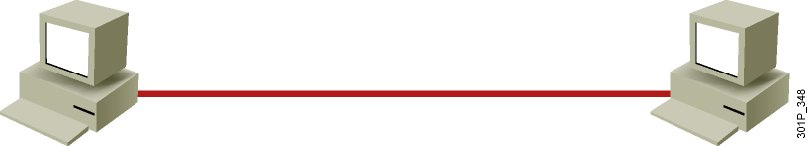
Understanding Host-to-Host Communications
Older model
Proprietary
Application and combinations software controlled by one vendor
Standards-based model
Multivendor software
Layered approach

Slide 11
Understanding Host-to-Host Communications
APPLE TALK
Standard
Interconnection
Development
Simplification
Proprietary
TCP/IP
DECNET

Slide 12
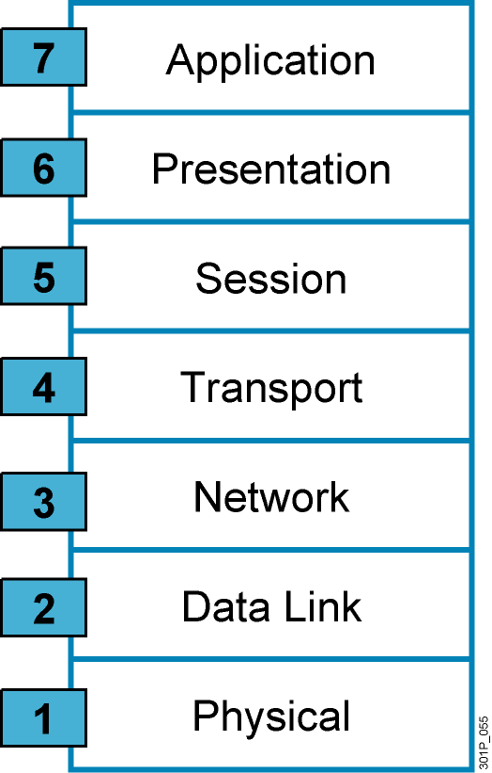
Why a Layered Network Model?
Reduces complexity
Standardizes interfaces
Facilitates modular engineering
Ensures interoperable technology
Accelerates evolution
Simplifies teaching and learning
Notes:
Lesson Aim
<Enter lesson aim here.>

Slide 13
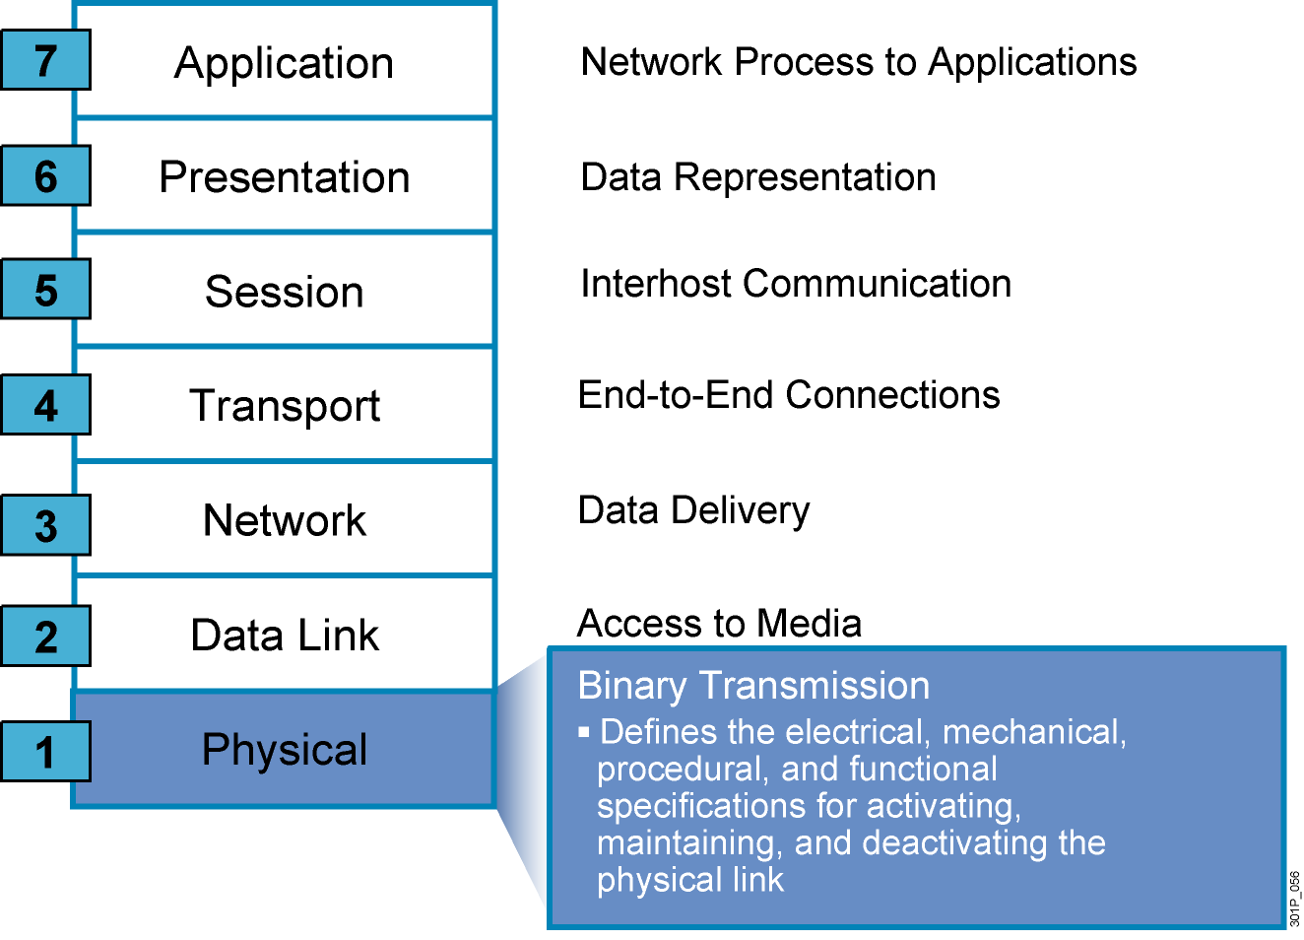
The Seven Layers of the OSI Model
Notes:
Lesson Aim
<Enter lesson aim here.>

Slide 14
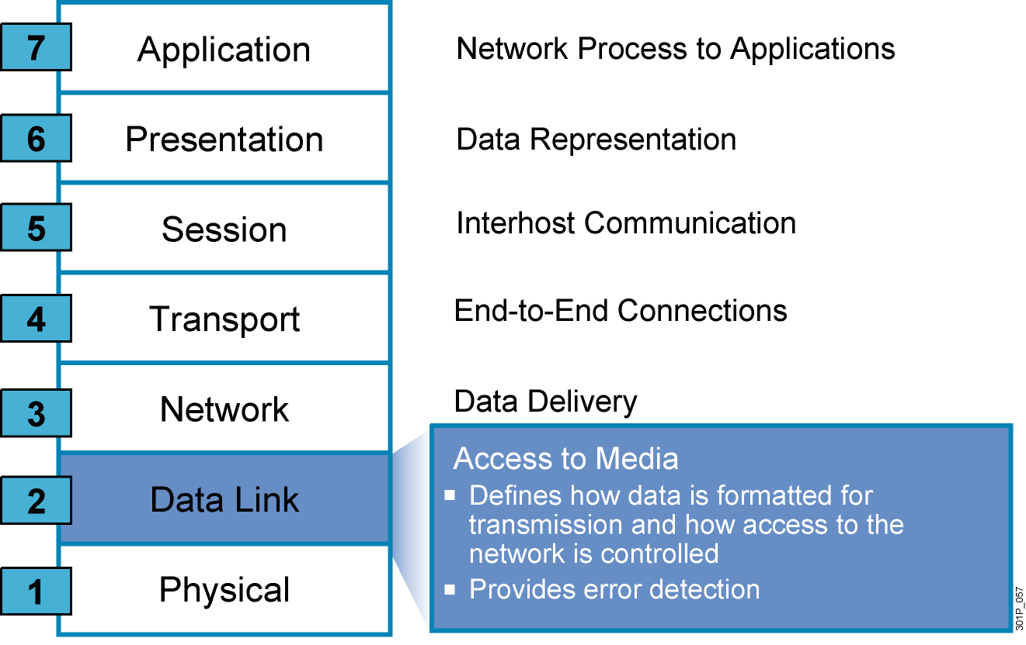
The Seven Layers of the OSI Model (Cont.)
Notes:
Lesson Aim
<Enter lesson aim here.>

Slide 15
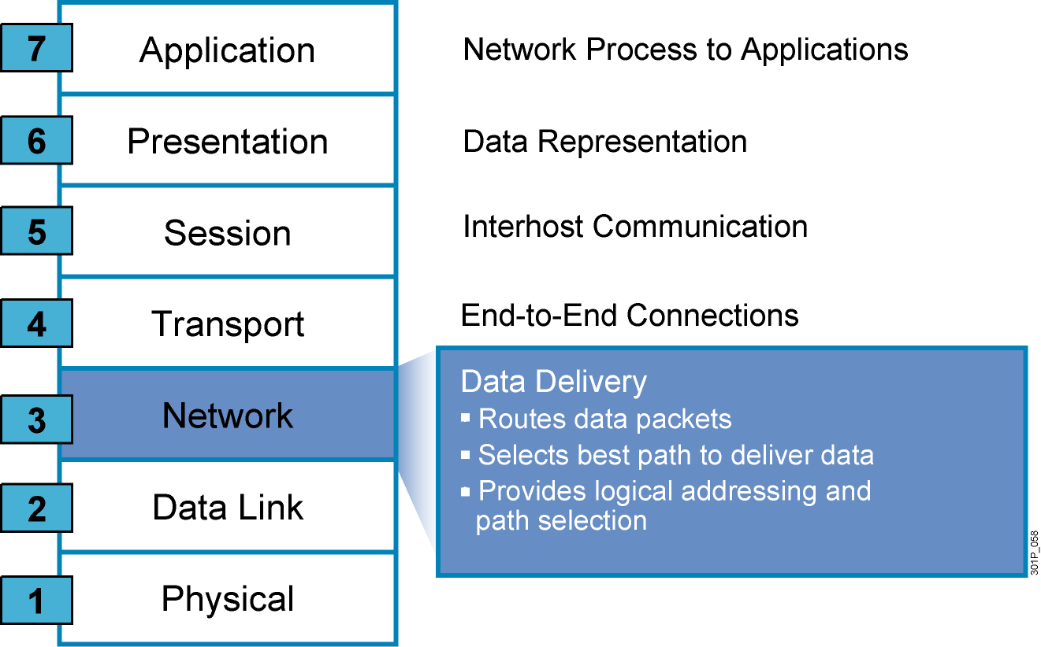
The Seven Layers of the OSI Model (Cont.)
Notes:
Lesson Aim
<Enter lesson aim here.>

Slide 16
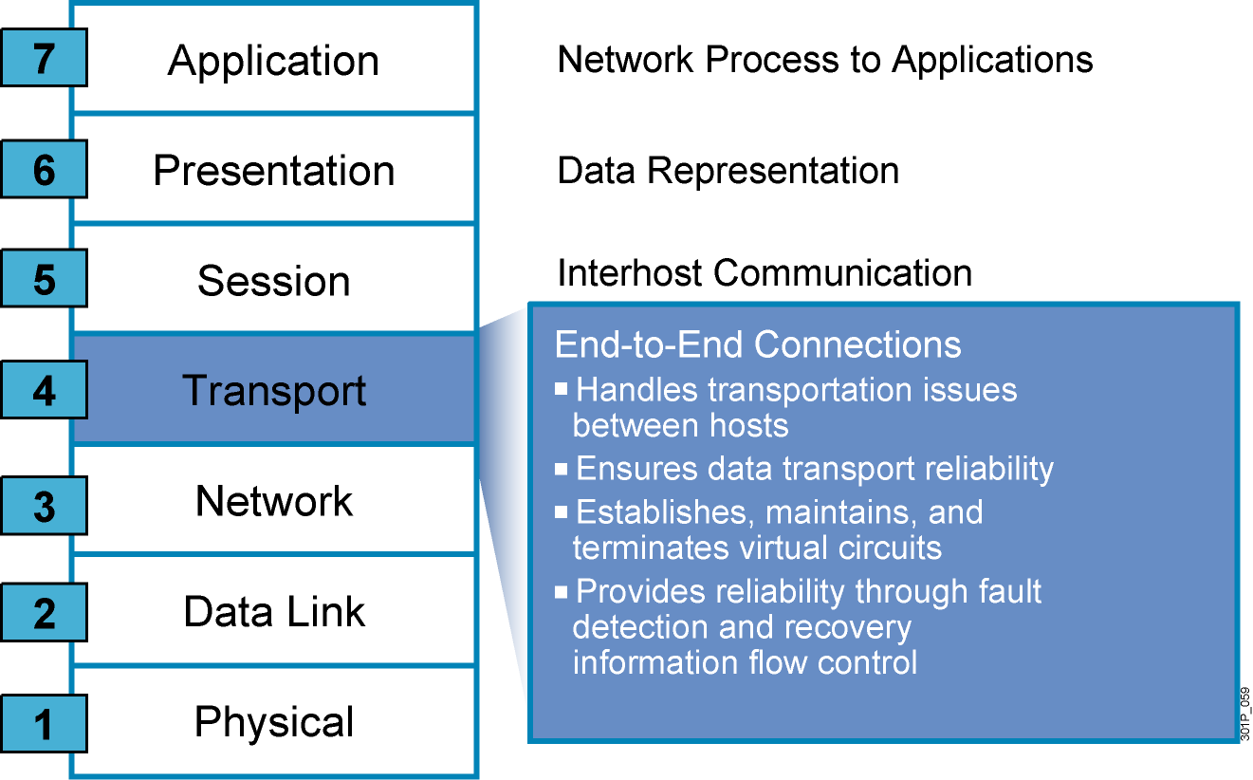
The Seven Layers of the OSI Model (Cont.)
Notes:
Lesson Aim
<Enter lesson aim here.>

Slide 17
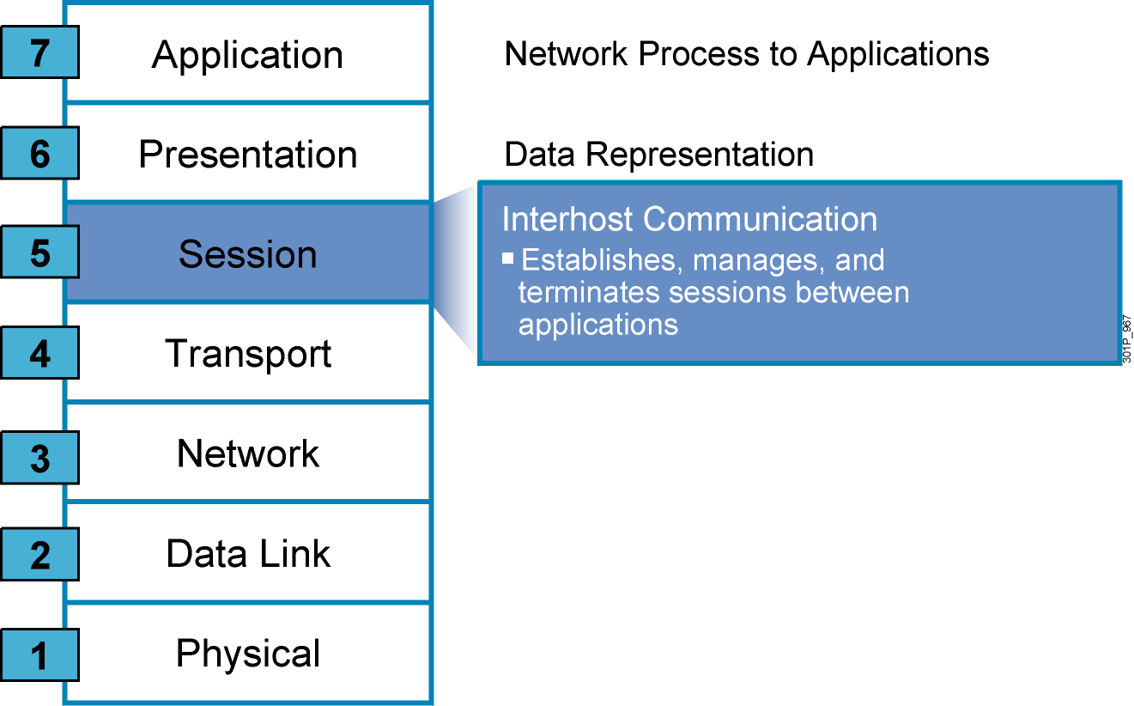
The Seven Layers of the OSI Model (Cont.)
Notes:
Lesson Aim
<Enter lesson aim here.>

Slide 18
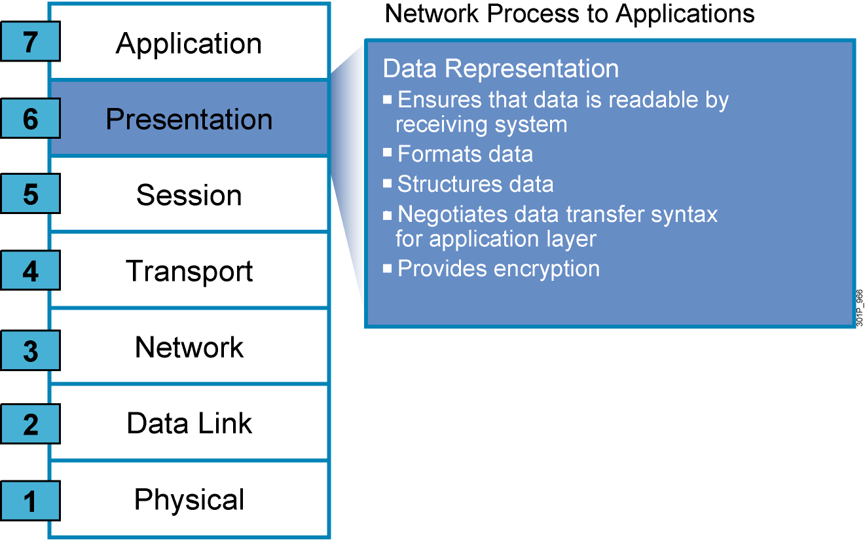
The Seven Layers of the OSI Model (Cont.)
Notes:
Lesson Aim
<Enter lesson aim here.>

Slide 19
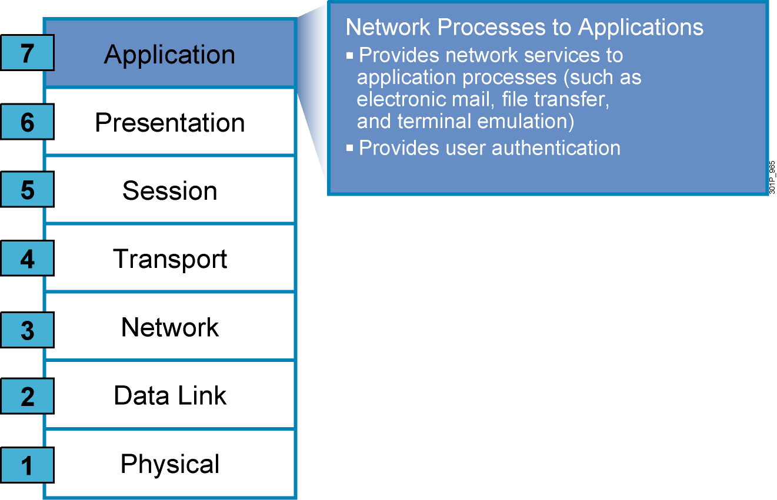
The Seven Layers of the OSI Model (Cont.)
Notes:
Lesson Aim
<Enter lesson aim here.>

Slide 20
Data encapsulation
& De-encapsulation

Slide 21

IP Header
IP Header
1
IP Header
1
1
IP Header
1
Frame Header
IP Header
I
Frame Header
IP Header
IP Header
1
I
IP Header
1
1
Frame Header
IP Header
1
I
1

Slide 22
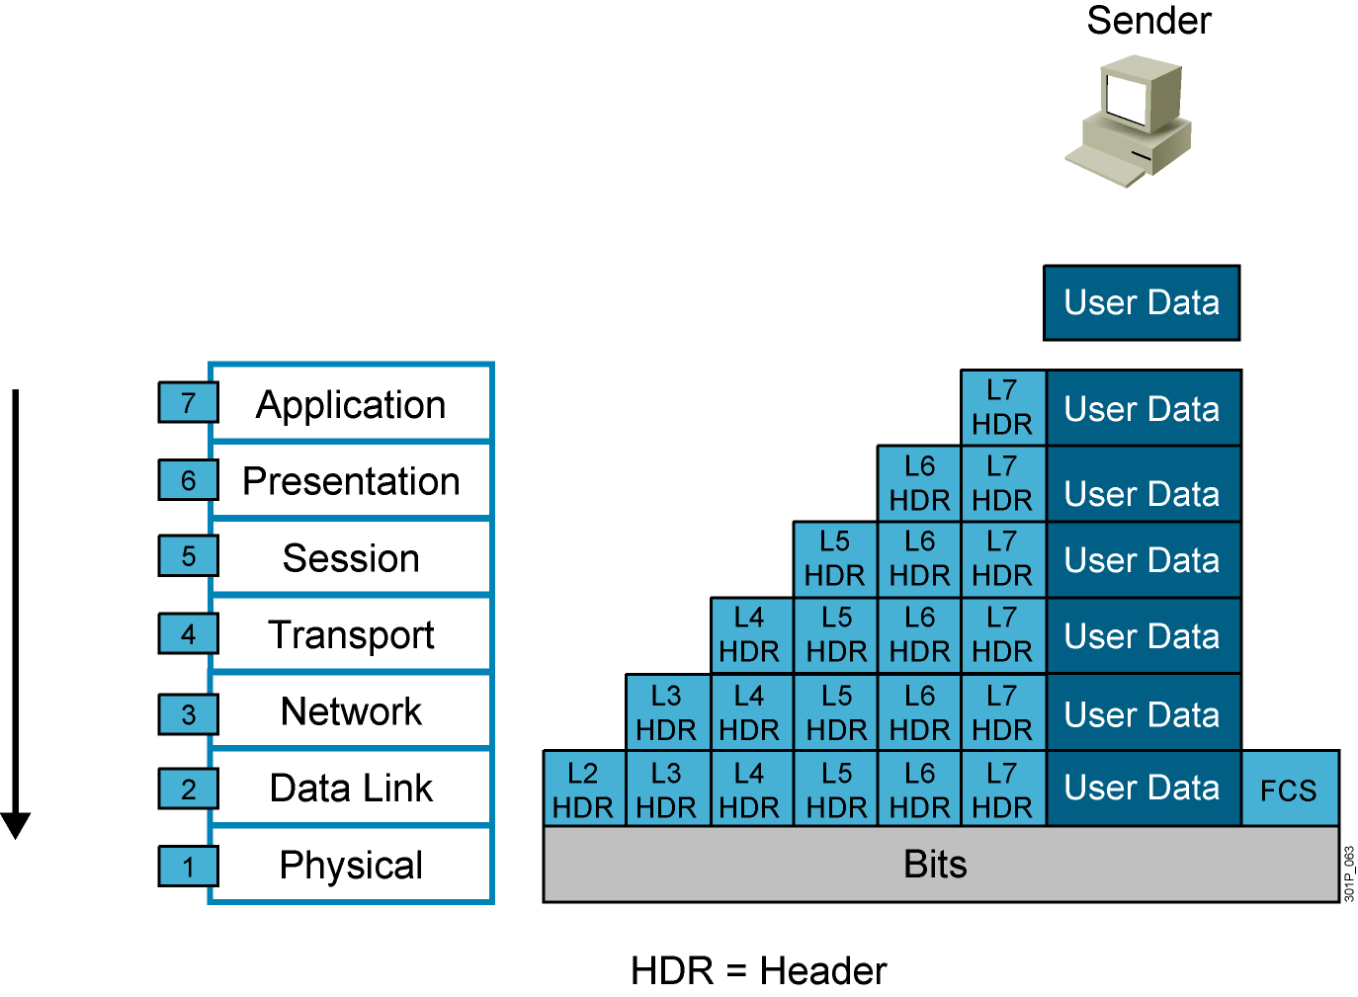
Data Encapsulation
Notes:
Lesson Aim
<Enter lesson aim here.>

Slide 23

Data De-Encapsulation
Notes:
Lesson Aim
<Enter lesson aim here.>

Slide 24
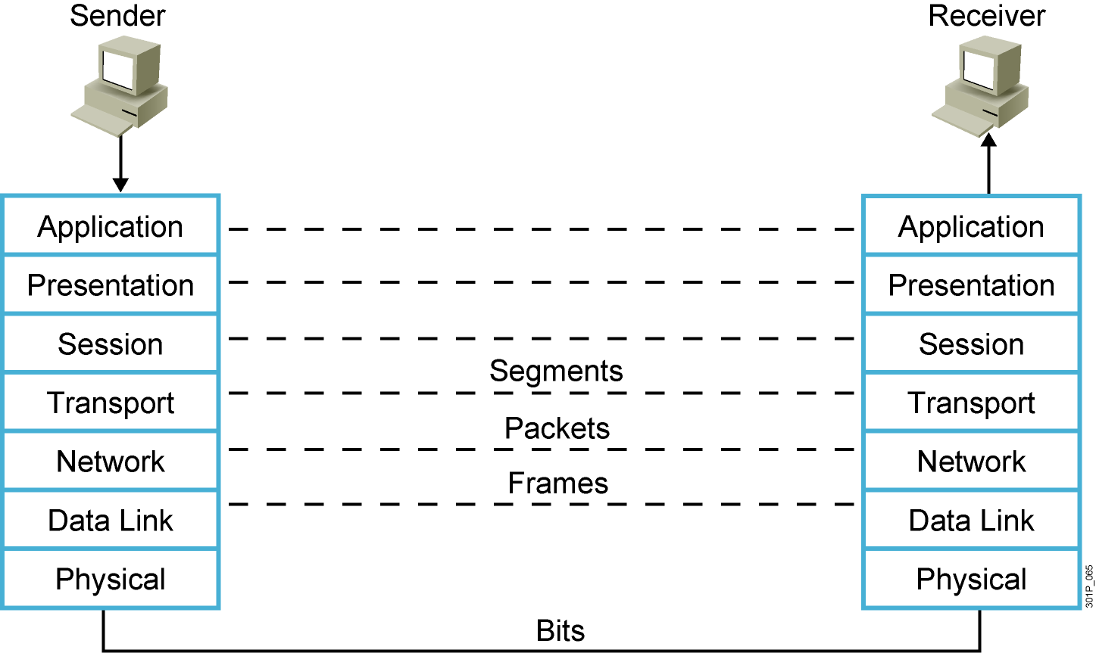
Peer-to-Peer Communication
Notes:
Lesson Aim
<Enter lesson aim here.>

Slide 25
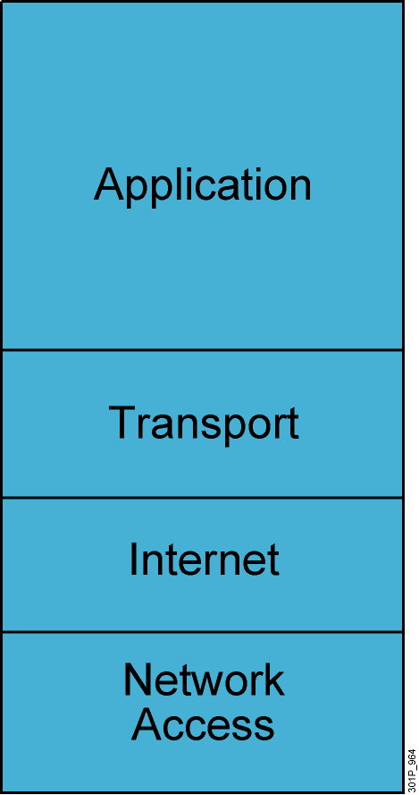
TCP/IP Stack
Defines four layers
Uses different names for Layers 1 through 3
Combines Layers 5 through 7 into single application layer
Notes:
Lesson Aim
<Enter lesson aim here.>

Slide 26
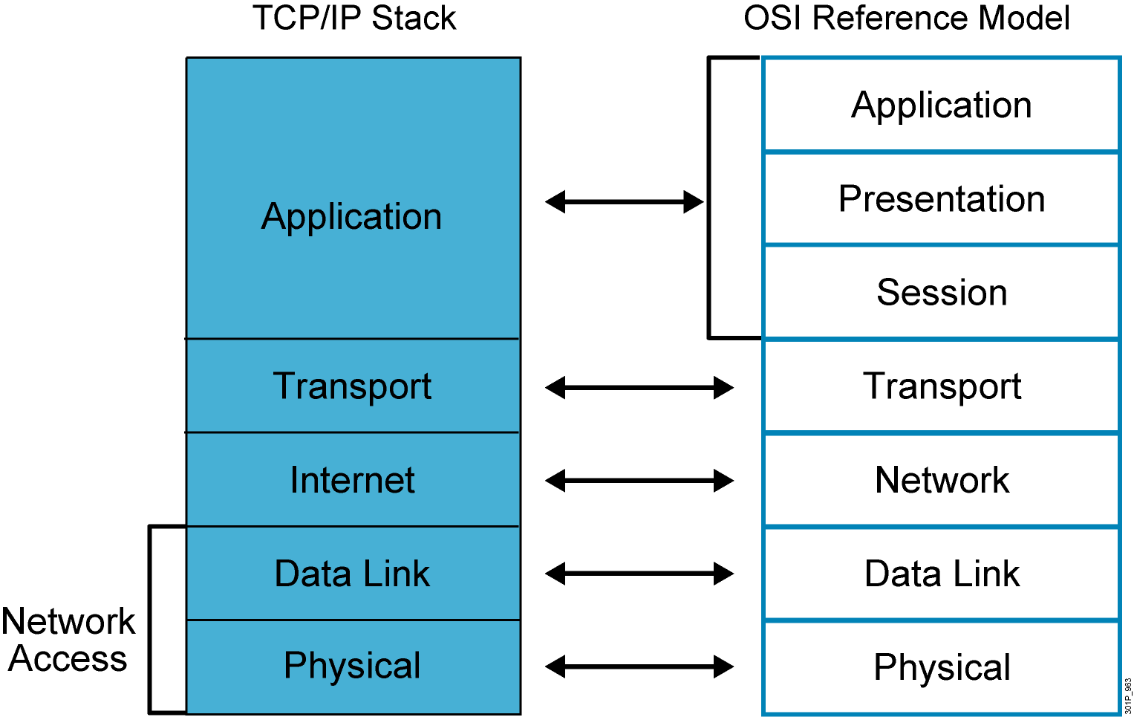
TCP/IP Stack vs. the OSI Model

Slide 27
Understanding the TCP/IP Transport layer

Slide 28
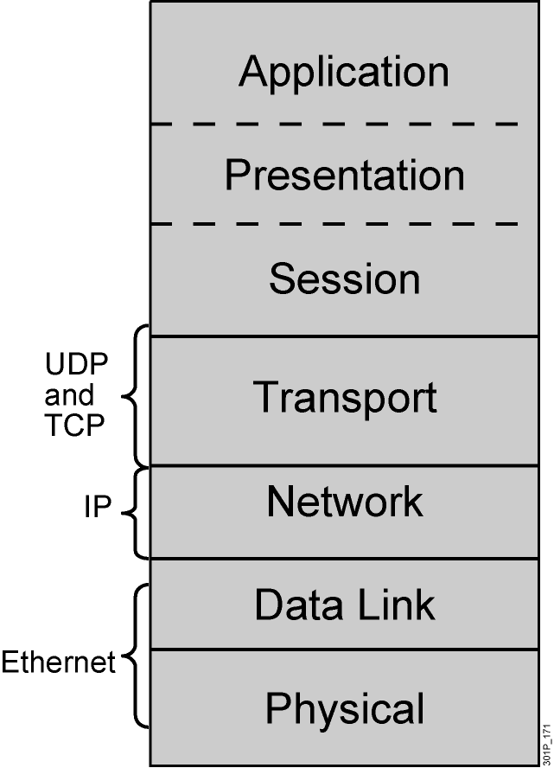
Transport Layer
Session multiplexing
Segmentation
Flow control (when required)
Connection-oriented (when required)
Reliability (when required)
Notes:
Lesson Aim
<Enter lesson aim here.>

Slide 29
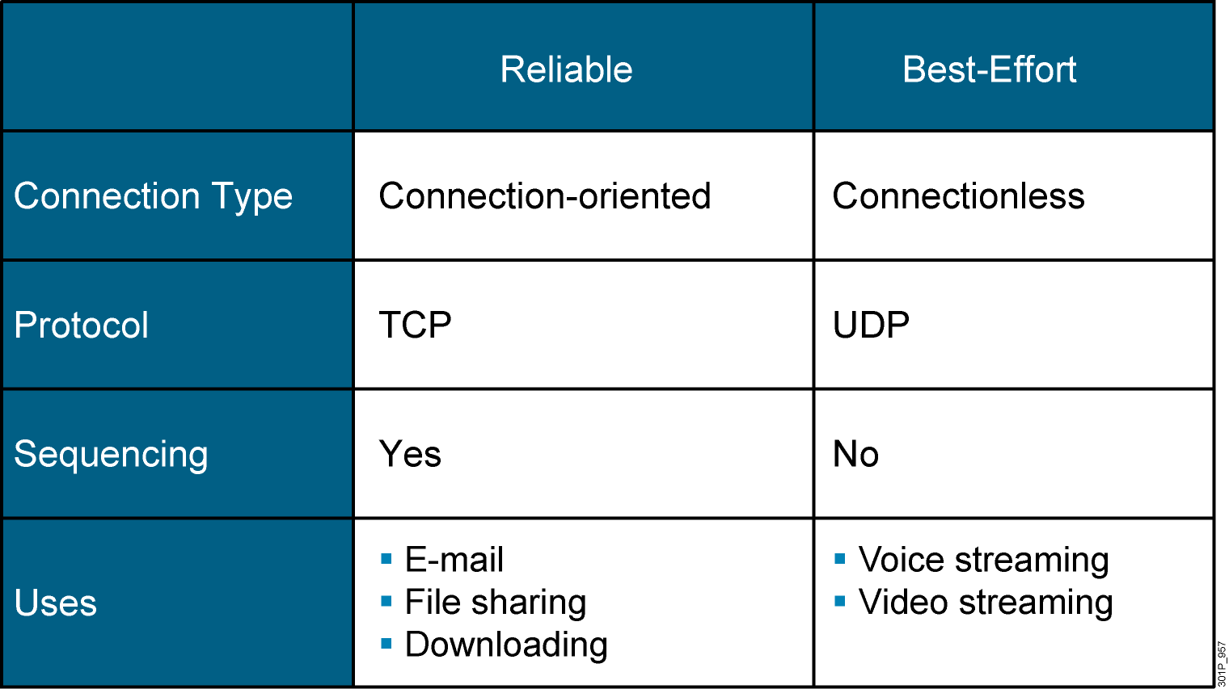
Reliable vs. Best-Effort Comparison

Slide 30
UDP Characteristics
Operates at transport layer of OSI and TCP/IP models
Provides applications with access to the network layer without the overhead of reliability mechanisms
Is a connectionless protocol
Provides limited error checking
Provides best-effort delivery
Has no data-recovery features

Slide 31
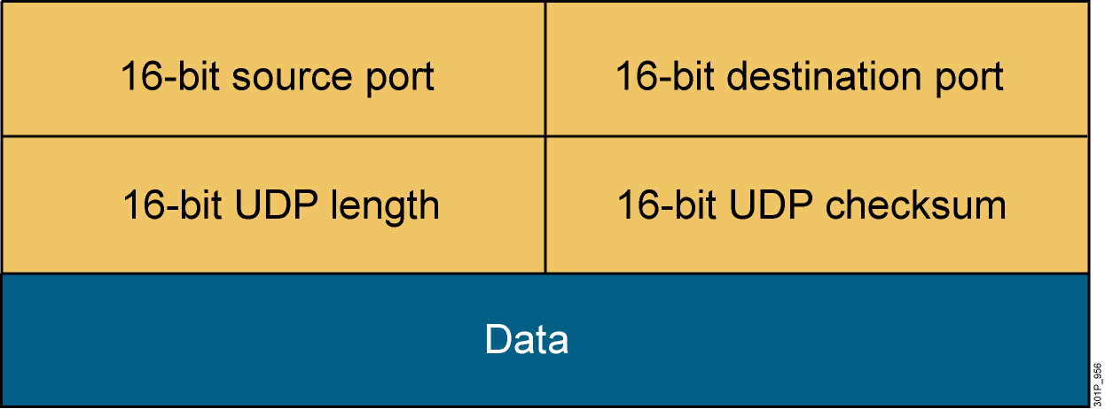
UDP Header
Notes:
Lesson Aim
<Enter lesson aim here.>

Slide 32
TCP Characteristics
Transport layer of the TCP/IP stack
Access to the network layer for applications
Connection-oriented protocol
Full-duplex mode operation
Error checking
Sequencing of data packets
Acknowledgement of receipt
Data-recovery features

Slide 33
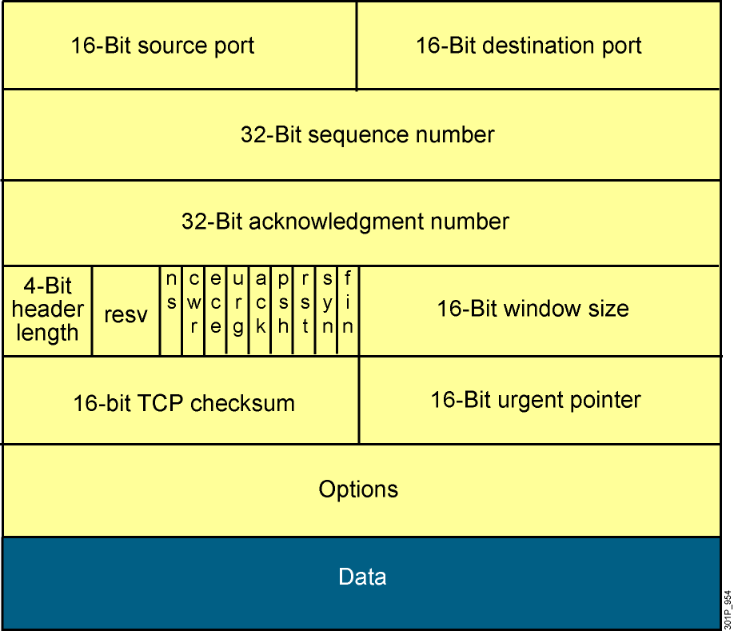
TCP Header
Notes:
Lesson Aim
<Enter lesson aim here.>

Slide 34
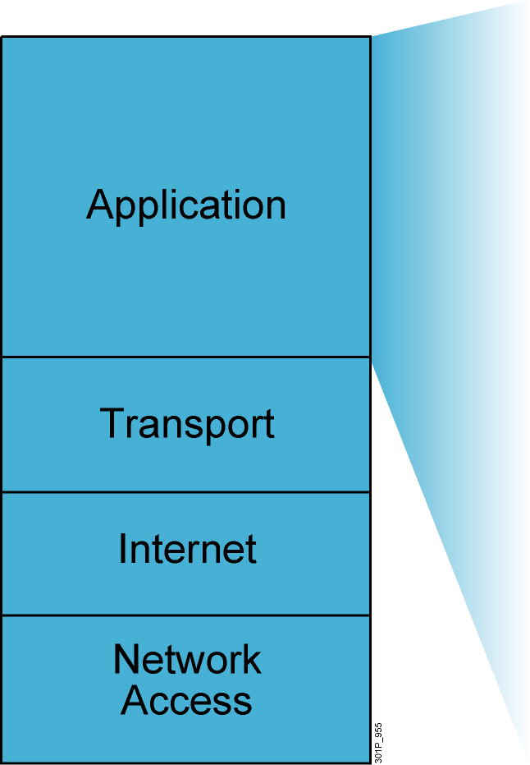
TCP/IP Application Layer Overview
File transfer
FTP
TFTP
Network File System
E-mail
Simple Mail Transfer Protocol
Remote login
Telnet
rlogin
Network management
Simple Network Management Protocol
Name management
Domain Name System
Notes:
Purpose: This figure discusses application-layer protocols.
Emphasize: The common network applications today include file transfer, remote login, network management, and e-mail.
We focus on TCP/IP in this course for several reasons:
TCP/IP is a universally available protocol and you will use it at work.
TCP/IP is a useful reference for understanding other protocols, because it includes elements that are representative of other protocols.
TCP/IP is important because the router uses it as a configuration tool. The router uses Telnet for remote configuration, TFTP to transfer configuration files and operating system images, and SNMP for network management.
Transition: The next section moves down the model to discuss the transport layer.

Slide 35
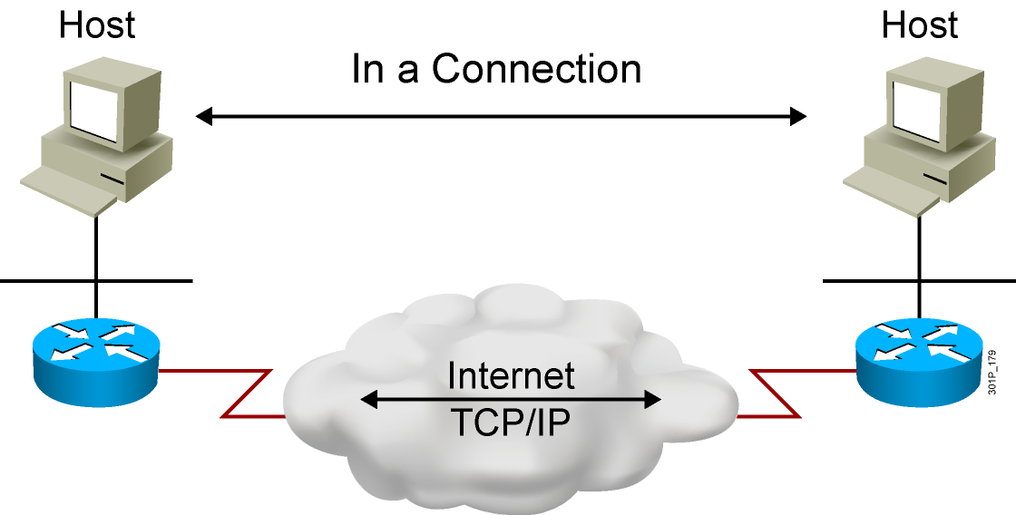
Establishing a Connection
Notes:
Lesson Aim
<Enter lesson aim here.>

Slide 36
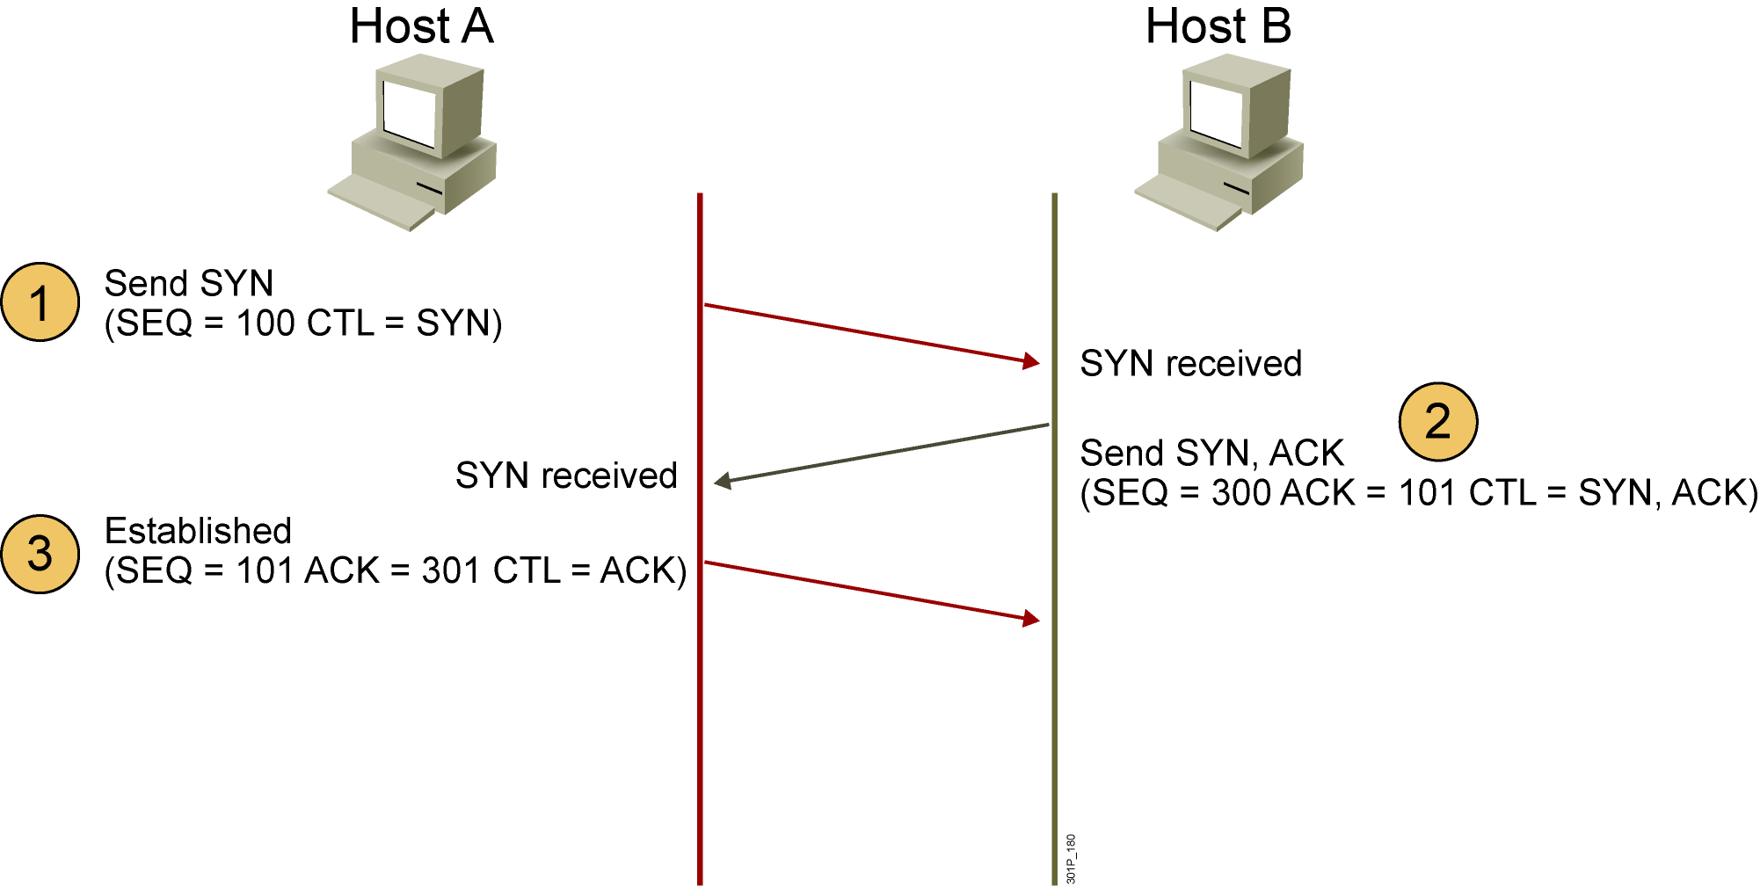
Three-Way Handshake
CTL = Which control bits in the TCP header are set to 1
Notes:
Lesson Aim
<Enter lesson aim here.>

Slide 37
Flow Control
Once data transfer is in progress, congestion can occur for two reasons.

Slide 38
Flow Control (tt)
First, the sending device might be able to generate traffic faster than the network can transfer it.

Slide 39
Flow Control (tt)
The second reason is that multiple devices need to send data to the same destination.

Slide 40

Flow Control (tt)
When datagram arrive too quickly for a device to process, it temporarily stores them in memory.

Slide 41
Flow Control (tt)
If the datagrams are part of a small burst, this buffering solves the problem.

Slide 42

Flow Control (tt)
However, if the traffic continues at this rate, the device eventually exhausts its memory and must discard additional datagrams that arrive.

Slide 43
Flow Control (tt)
Instead of losing the data, the transport function can issue a “not ready” indicator to the sender.

Slide 44
Flow Control (tt)
This acts like a stop sign and signal the sender to discontinue sending segment traffic to the receiver.

Slide 45
Flow Control (tt)
After the receiving device has processed sufficient segments to free space in its buffer, the receiver sends a “ready transport “ indicator – which is like a go signal.

Slide 46
Flow Control (tt)
When they receives this indicator, the senders can resume segment transmission.

Slide 47
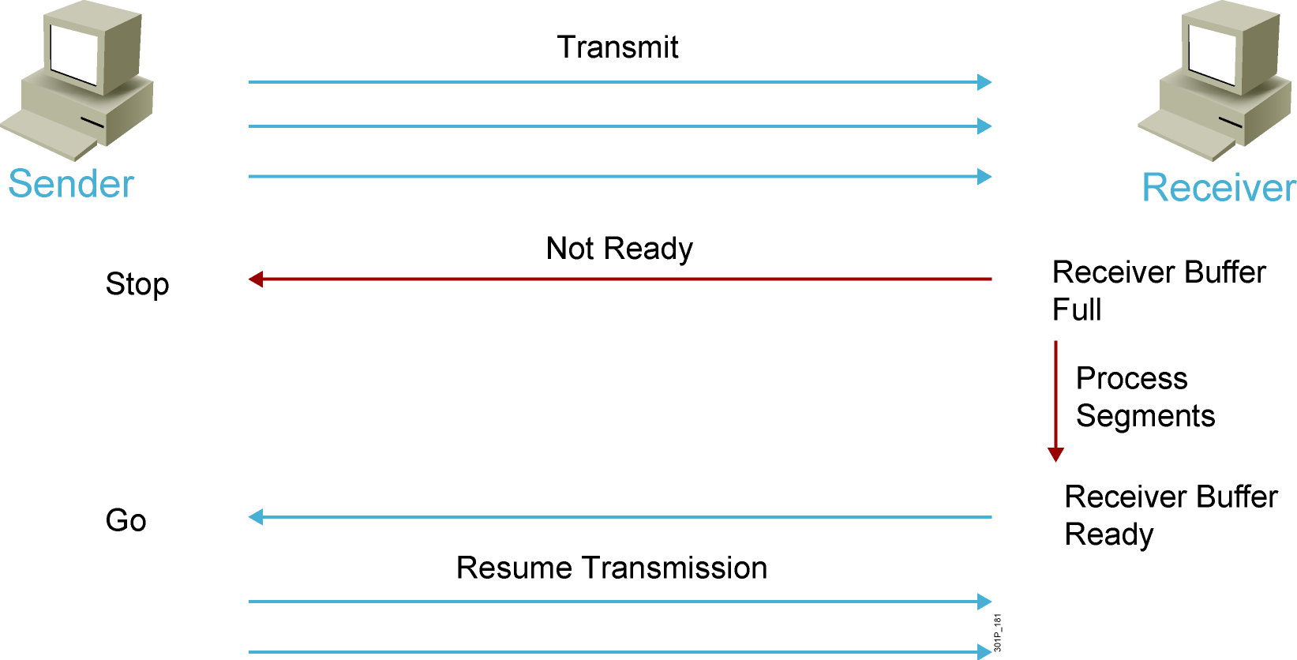
Flow Control (tt)
Notes:
Lesson Aim
<Enter lesson aim here.>

Slide 48
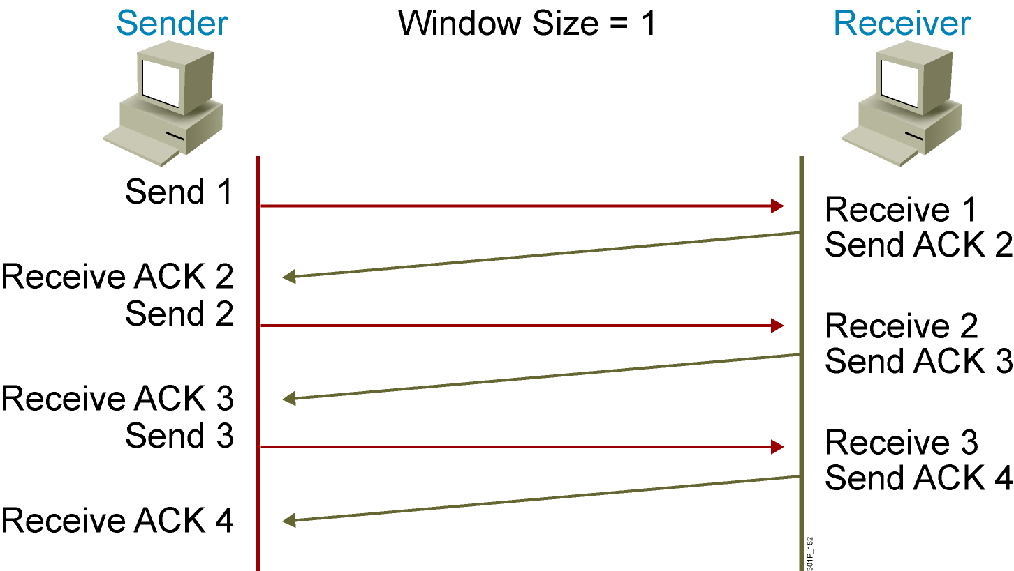
TCP Acknowledgment
Notes:
Lesson Aim
<Enter lesson aim here.>

Slide 49
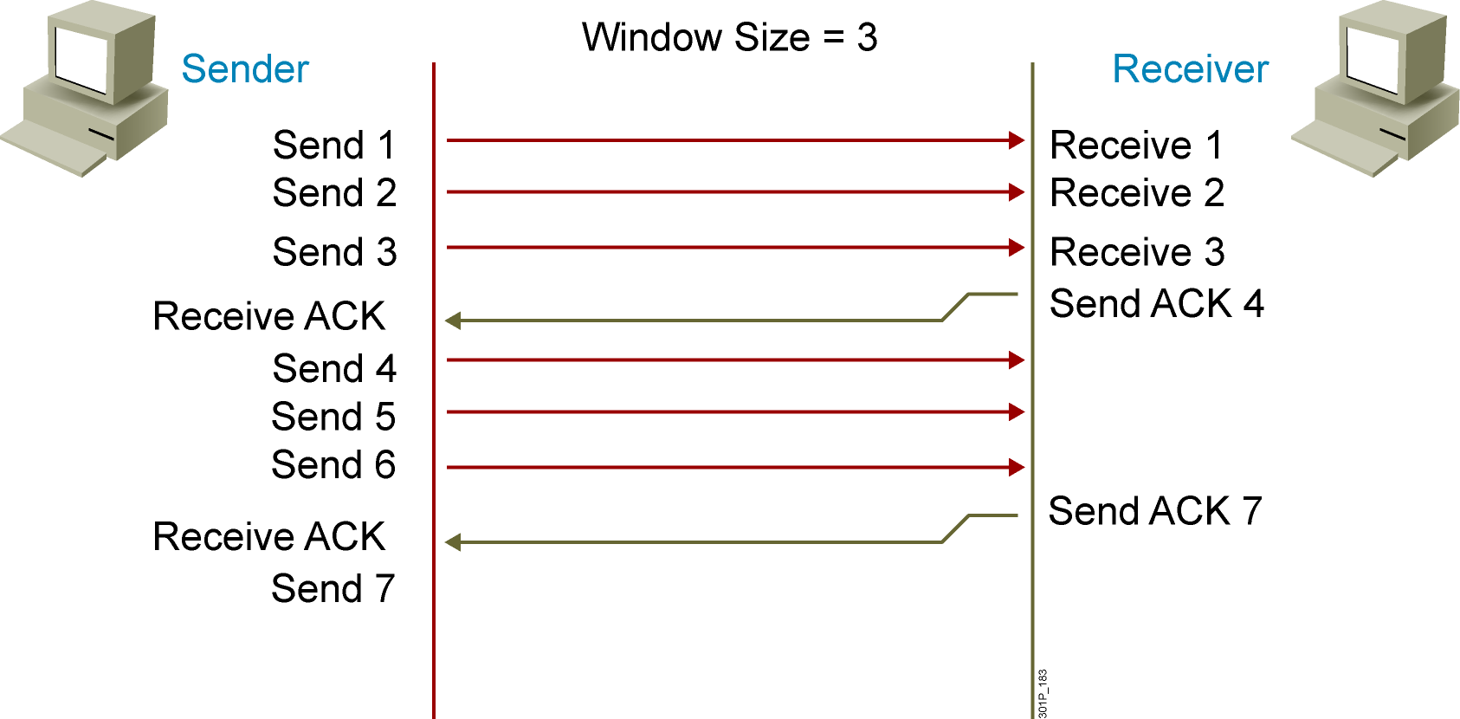
Fixed Windowing
Notes:
Lesson Aim
<Enter lesson aim here.>

Slide 50
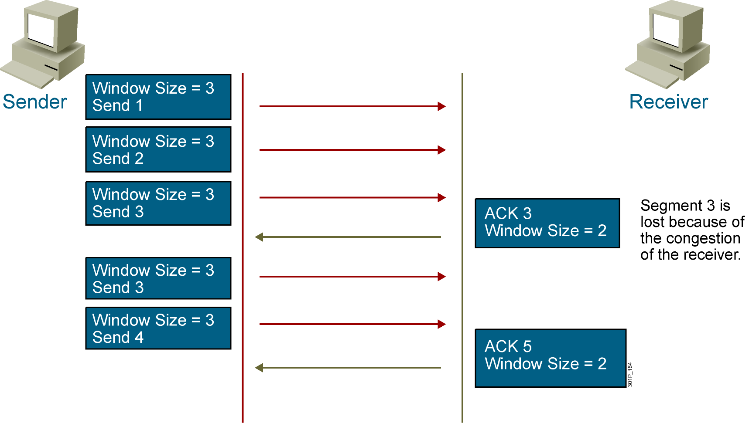
TCP Sliding Windowing
Notes:
Lesson Aim
<Enter lesson aim here.>

Slide 51
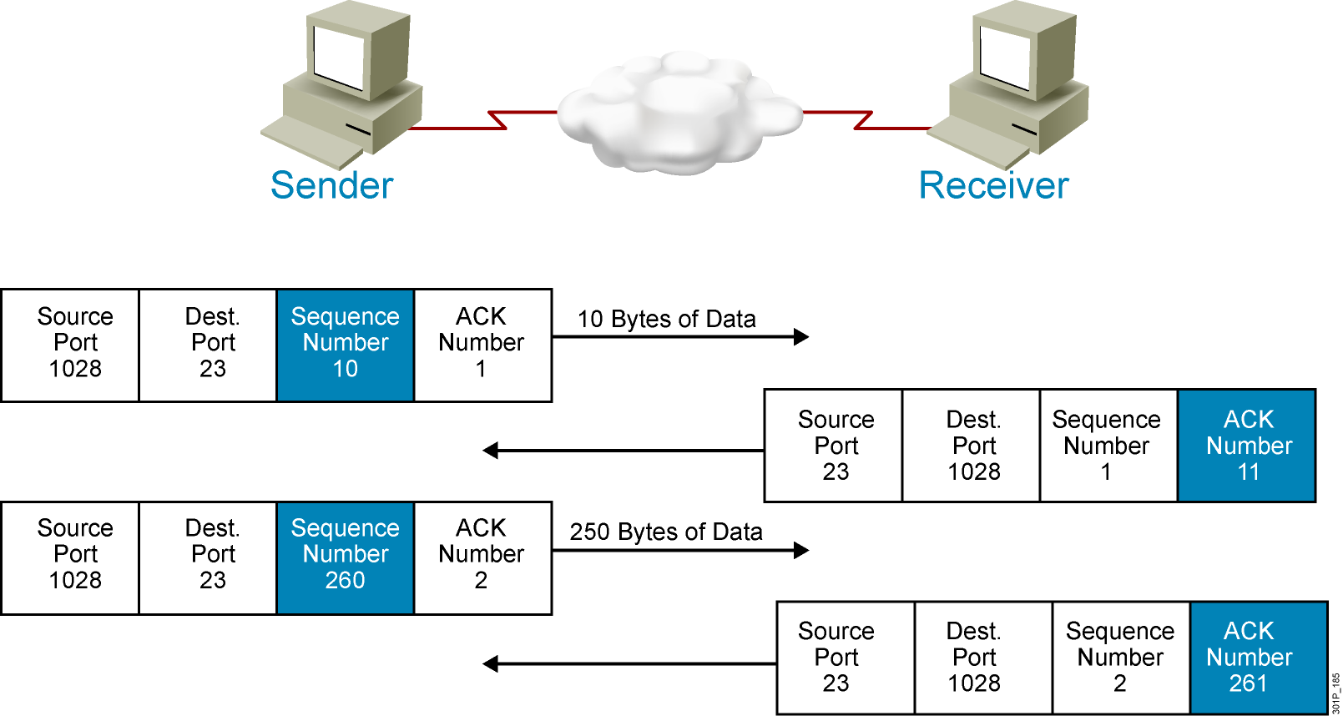
TCP Sequence and Acknowledgment Numbers
Notes:
Lesson Aim
<Enter lesson aim here.>

Slide 52
Mapping Layer 3 to Layer 4

Slide 53
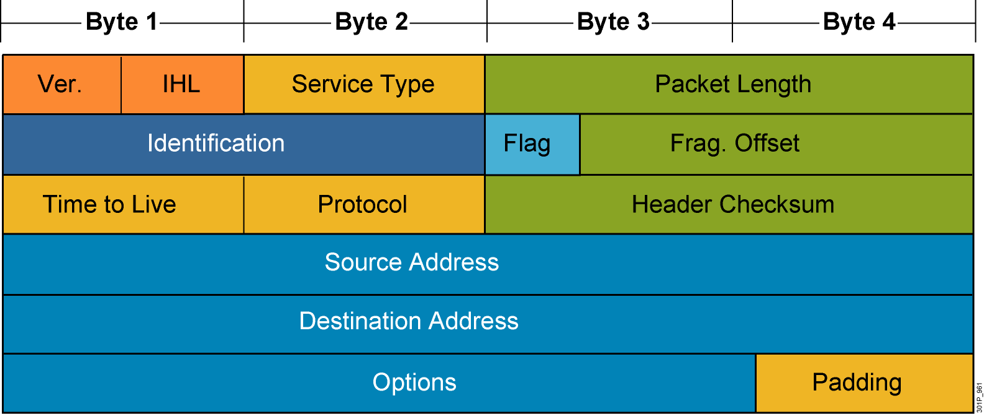
Mapping Layer 3 to Layer 4
Notes:
Lesson Aim
<Enter lesson aim here.>

Slide 54
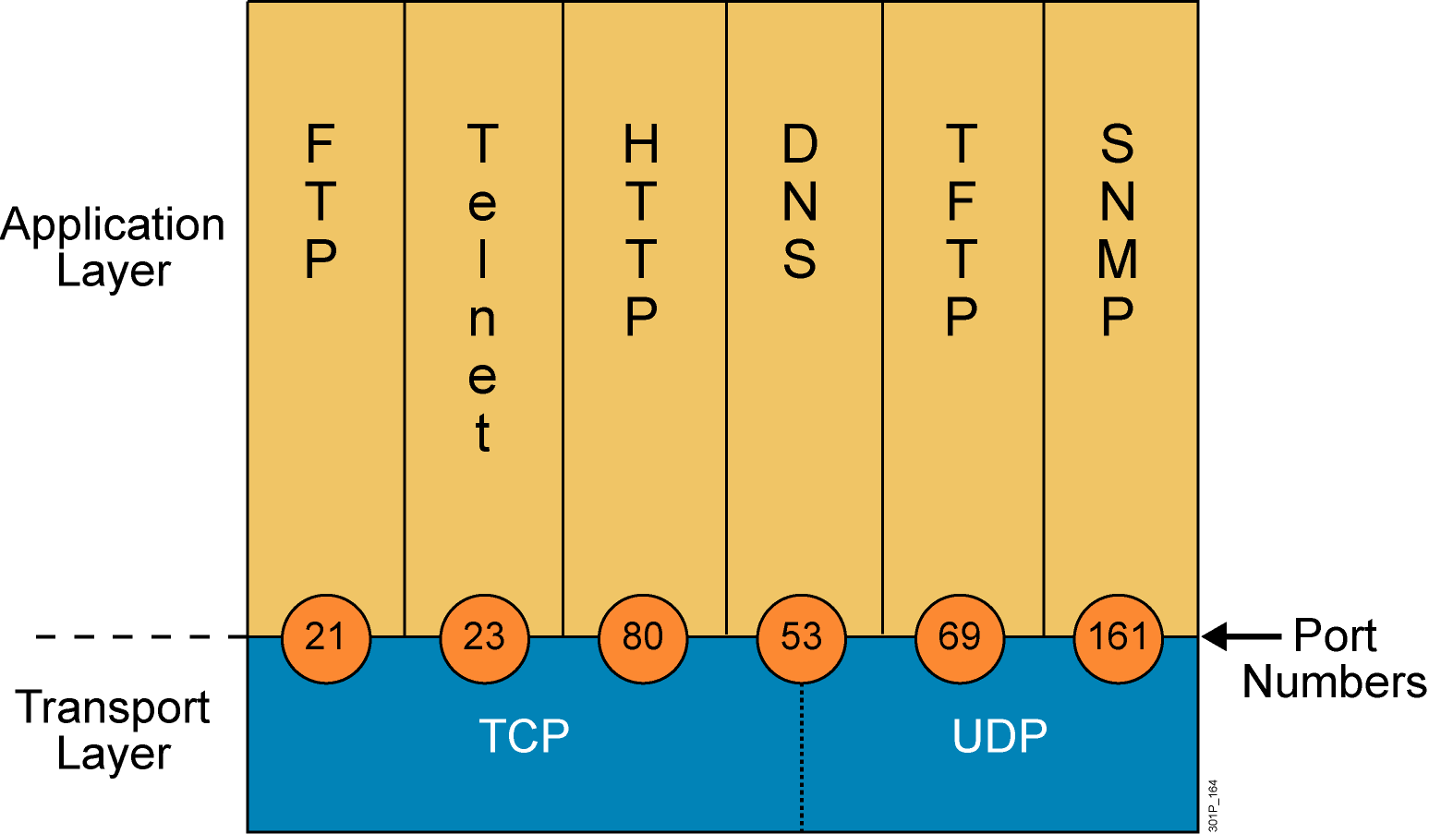
Mapping Layer 4 to Applications
Notes:
Lesson Aim
<Enter lesson aim here.>

Slide 55
????

